Slide 1


Teaching Pathologists
How To Code
How to Fix the Data Literacy Crisis in Medical Education
Stephan Kadauke, MD, PhD
Amrom Obstfeld, MD, PhD
July 27th, 2021
APC Annual Meeting
Notes:
Discuss the text as a summary level

Slide 2
Disclosures
None relating to anything I will be talking about today.
Notes:
I have no disclosures relating to the topic I’m discussing today.

Slide 3
So far…
Why we teach
What we teach
How we teach

Slide 4
Teaching Reproducible Data Analysis

Slide 5

Coding is for Analysts
Reproducibility is overblown
Coding is too hard
Not enough Time

Slide 6
Important concepts in R programming
R
Rstudio
Environment
Console
Editor
Function
Argument
Output
Object
Assignment
Tidyverse
Tidy Data
Dataframe
Pipe
Dplyr
Ggplot2
Vector
List
NA
Working Directory
Project
CSV
Package
Error
Warning
Rmarkdown
Markdown
Reproducibility
Dashboard
Data Types
HTML
Pipe
Latex
Linear Model
Iteration
Strings
Tibbles
Joins
Factors
Notes:
There's no escaping the fact that programming is a discipline with many concepts that pathology learners are not familiar with. Given this its very easy to blow people away with just a bit of jargon, and that’s certainly happened.
We have a two fold approach to avoiding this. The first is to assist our learners in building good mental models.
Generally speaking a model is a simplified representation of something more complex that can be useful. In this context a mental model is a simplified representation of the key elements and relationships of the domain that is good enough to support problem solving.

Slide 7

Notes:
With that it in mind I began thinking of the saying
Give a man a fish and you feed him for a day. Teach a man to fish and you feed him for a lifetime.
If the goal is for our learners to go off and do great data analysis independently – we should aim to teach them the craft of using R for reproducible data analysis, but given the limitations of time and cognitive resources – we just don’t have the banndwith to do even than.
→

Slide 8
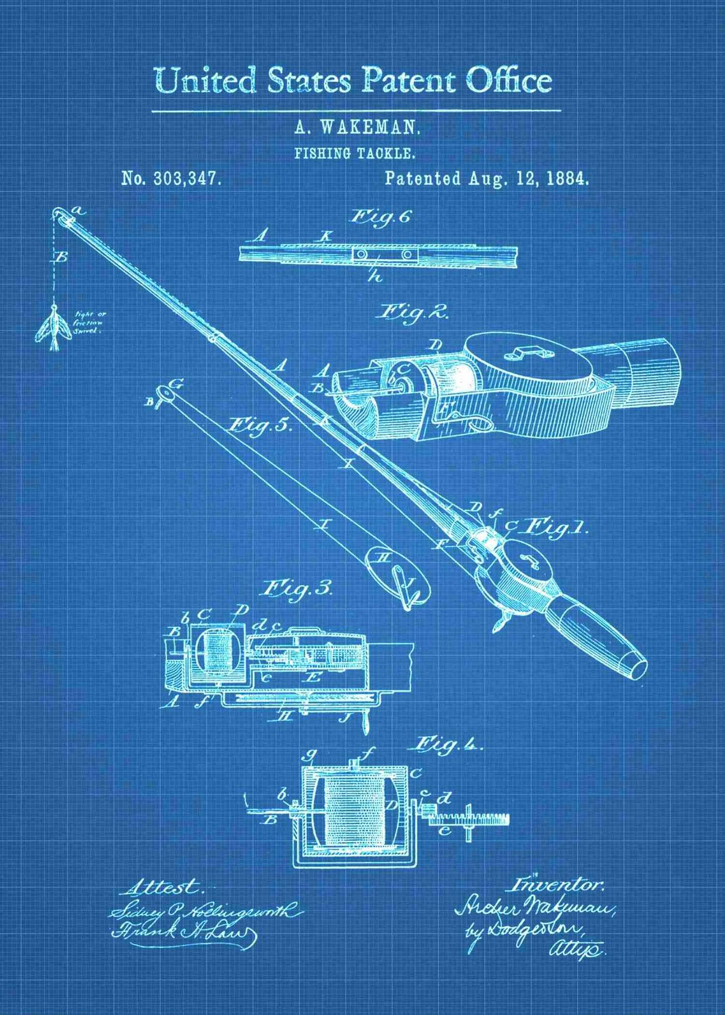
Notes:
Rather what we can reasonably aim to do is give the learners the blueprint of reproducibility – the tools they need – so that they have a starting point and the tools to put the whole picture together for themselves

Slide 9

Notes:
As we considered how we would tackle this issue we turned to a fantastic resource – the book Teaching Tech Together by Greg Wilson who is best known as the co-founder of Software Carpentry, a non-profit organization that teaches basic computing skills to researchers, and is now part of the education team at RStudio.

Slide 10
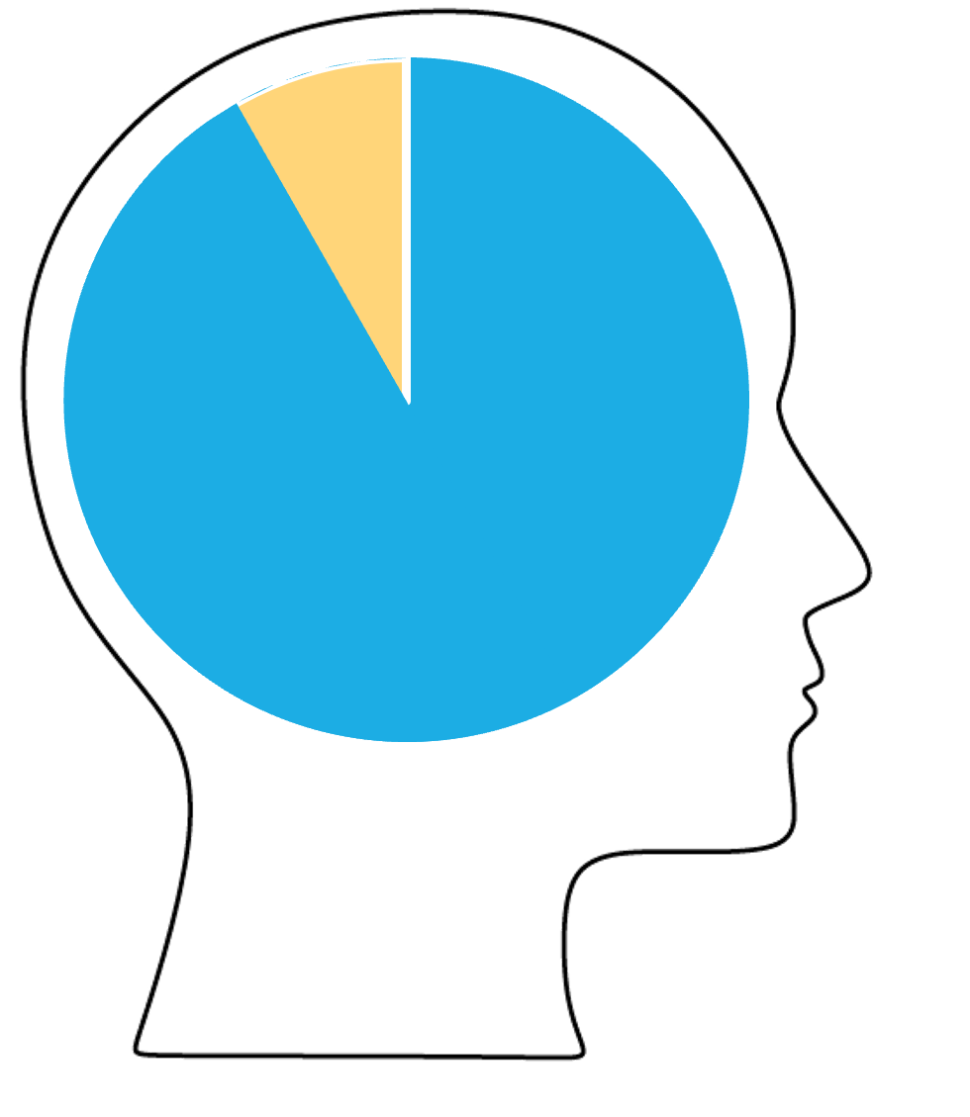

Cognitive Load Theory
Extrinsic Load
Intrinsic Load
Notes:
One of the concepts that he hammers home is critical to both what we teach and how we teach it. It’s the idea that despite the fact that as teachers we're really excited and we think that every bit of information is useful there are limits to the amount of information we can teach, an idea subsumed within cognitive load theory.
Cognitive load theory begins with the idea that the material being presented in a lesson can either be intrinsic to the lesson or extraneous to it. Intrinsic load carries the meaning behind what is being taught while extraneous load both distracts from the instrinc facts and also consumes cognitive resources that can be used for instrinsic load.
It also proposes that there is a bottleneck that limits the rate at which new ideas can be fixed into memory.
→So to state the obvious, the goal of a teacher should be to maximize the intrinsic load contained in the lesson while minimizing extrinsic load.
→At the same time there are strategies that a teacher can use to allow a student to take in and commit to memory more information. Sort of like expanding the pie.

Slide 11
THE WORKSHOP APPROACH
Notes:
Given that we have these restraints on what and how we can teach we gravitated towards the concept of a workshop over a lecture series. So why a workshop?

Slide 12
Your Turn 1
A
B
Notes:
So let's do a quick exercise, take out a sheet of paper and write A and B at the top.
For the next few minutes, we will compare a series of statements. In each case, note whether you agree more with statement A or statement B. At the end we can tally up our answers and compare notes.

Slide 13
SURVEY: Do you learn better when you…
A
B
Read about something
Try to use something
Notes:
Think back to a time when you were trying to learn a new skill, like how you scan lymph nodes for metastases, did you learn better when you read about how to do it, or tried doing it?

Slide 14
SURVEY: Do you learn better when you…
A
B
Watch a video
Do exercises
Notes:
What about watching a video versus doing exercises?

Slide 15
SURVEY: Do you learn better when you…
A
B
Attend a lecture about something
Discuss the topic with an expert
Notes:
How about attending a lecture versus discussion a problem with an expert?

Slide 16
SURVEY: Do you learn better when you…
A
B
Having a concept explained to you
Try to explain the concept to someone else
Notes:
having something explained to you versus explaining it to
someone else

Slide 17
A
B
Read about it
Watch a video
Attend a lecture
Hear it explained
Passive (teacher centered)
Try it
Do exercises
Discuss with an expert
Try to explain it
Active (student centered)
Notes:
Alright, let's tally our votes. Type in the chat an A or B based on which set of statements best characterized your experience as a learner.
How can you describe the differences between these two columns, type your answer in the chat.
Column A are all passive from the student's point of view: the teacher does
something and the student watches. This is called “teacher-led
learning”, and is typical of colleges class with assigned readings,
lectures, and homework exercises that learners are supposed to do
on their own without collaborating.
CC BY-

Slide 18
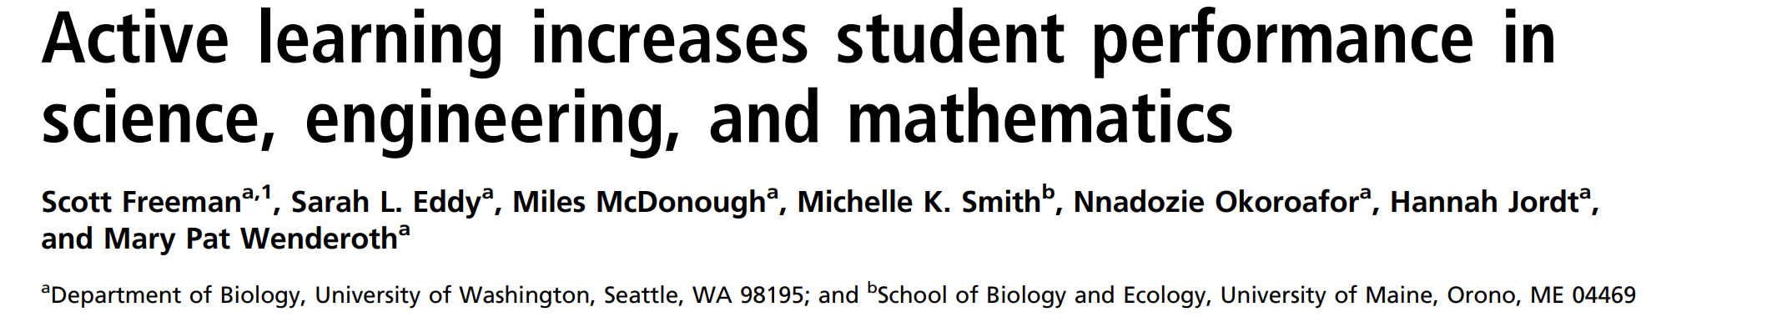
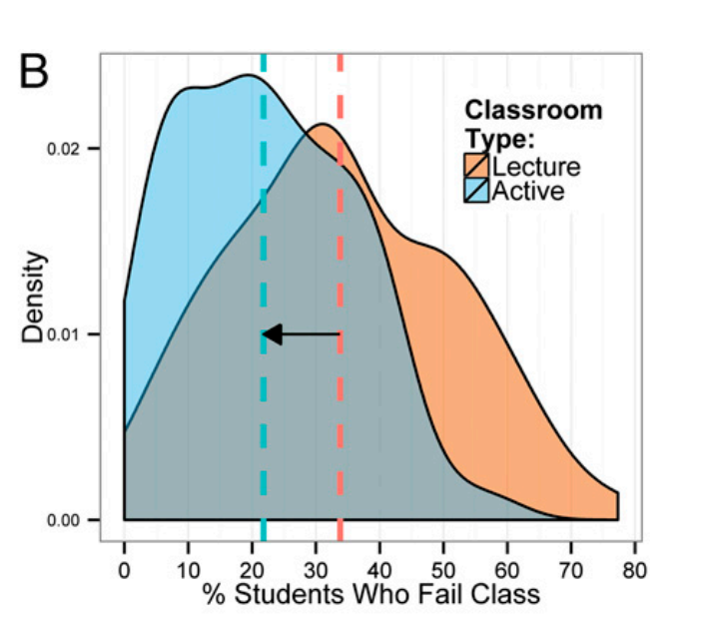
Notes:
Studies in the area of STEM education are necessarily not always as well controlled as basic science research but this meta analysis published recently in PNAS seems to corroboerate the idea that active learning leads to to better student performance, here we're seeing a that amongst over 250 studies of active vs lecture based learning the % of students who failed class was lower in active learning environments

Slide 19
Active Learning
Group problem-solving
Worksheets
Tutorials
Personal response systems
Workshops
Notes:
So what is subsumed under active learning, well it’s a wide variety of activities ranging from
Group problem-solving
Worksheets
Tutorials
Personal response systems
Workshop designs
The lesson here was that at least for teaching a practice, such as data analysis skills, we would have more success if we used instructional design such as a workshop compared to lecture formats.

Slide 20
Workshop Design
Transmit Information
Short Term Memory
Apply Information
Notes:
That is why we opted for a workshop where we could strongly emphasize active learning techniques. We set up a positive feedback loop where after reviewing a concept the new idea is the explored with interactive “Your Turn” type exercises and live coding. This creates a positive feedback loop because there are standard patterns in the way you use R, so once you understand a basic function you can use the pattern to more easily add on new functions.

Slide 21
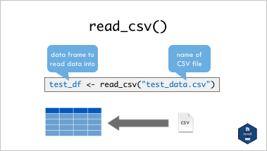
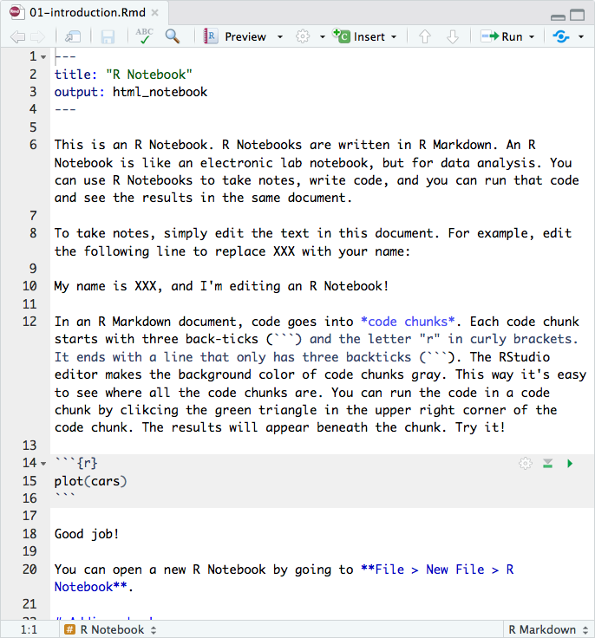
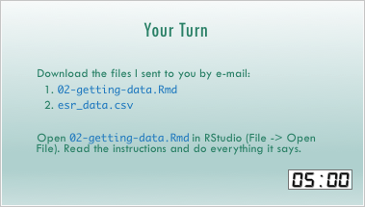
Notes:
the way that we do this is by starting with a slide deck to teach the coding basics. This in and of itself is significant because generally coding workshops are very heavy on IDE's or integrated development environments. By starting with a powerpoint we isolate just the point that is being taught and remove all the other distracting elements.
But then we We can then show students what this looks like in the Rstudio environment,
And Then toggle to exercises which we call Your Turns that allow the students to start rehearsing the mental model, building muscle memory around it, which helps encode the information for long term storage.

Slide 22
Build Mental Models
R
Rstudio
Environment
Console
Editor
Function
Argument
Output
Object
Assignment
Tidyverse
Tidy Data
Dataframe
Pipe
Dplyr
Ggplot2
Vector
List
NA
Working Directory
Project
CSV
Package
Error
Warning
Rmarkdown
Markdown
Reproducibility
Dashboard
Data Types
HTML
Notes:
There's no escaping the fact that programming is a discipline with many concepts that pathology learners are not familiar with. Given this its very easy to blow people away with just a bit of jargon, and that’s certainly happened.
We have a two fold approach to avoiding this. The first is to assist our learners in building good mental models.
Generally speaking a model is a simplified representation of something more complex that can be useful. In this context a mental model is a simplified representation of the key elements and relationships of the domain that is good enough to support problem solving.

Slide 23
Important concepts in R programming
R
Rstudio
Environment
Console
Editor
Function
Matrix
Output
Object
Assignment
Tidyverse
Tidy Data
Dataframe
Pipe
Dplyr
Ggplot2
Vector
List
NA
Working Directory
Project
Filepaths
Package
Error
Warning
Rmarkdown
Namespace
Reproducibility
Dashboard
Data Types
HTML
Pipe
Latex
Linear Model
Iteration
Strings
Tibbles
Joins
Factors
Notes:
Next we focused on what material we would cover. R is great for statistics and data analysis but can do a huge range of tasks, but as I said earlier, with limited cognitive bandwidth we had to be ruthlessly efficient in our workshop.
Therefore the first application of this cognitive based teaching for the workshop was to
→rip out content that, although we felt was very important, and maybe ciritical for other pursuits, was not as important when it came to our main focus which is reproducibility.

Slide 24
The Data Analysis Pipeline
From R for Data Science (https://r4ds.had.co.nz/introduction.html)
Notes:
Instead we focused on the concepts and tools that drive high reliability data analysis

Slide 25
Session | Day 1
Instructor Introductions | 1:00 pm - 1:30 pm
Introduction to R and RStudio | 1:35 pm - 2:00 pm
Reproducible Reporting | 2:15 pm - 3:15 pm
Data Visualization | 3:30 pm - 5:00 pm
 | Day 2
Data Transformation | 1:00 pm - 2:30 pm
Statistical Analysis | 2:45 pm - 4:15 pm
Advanced Reporting | 4:30 pm - 5:00 pm
The Data Analysis Pipeline
Notes:
And we use it as the blueprint for the workshop – it essentially serves as both a model for the idealized data analysis workflow but also for the course itself.

Slide 26
A
B
C
E
D
F
Novice
Notes:
Once we had pared what we could teach down to the bone we began looking at ways we could most effectively relay the information.
Here we decided whenever possible to provide learners with frameworks or mental models for linking together the concepts we were teaching to each other or to some other concept they would be familiar with.
Novices generally don’t have a lot of connections between concepts. There just beginning to understand how concept A connects to B, How A is the main point and B and C are secondary points

Slide 27
A
B
A
A
B
B
C
C
C
E
E
E
D
D
D
F
F
F
Novice
Competent
Notes:
Competent practitioners have more connections, and in attion to the quantitative change in connections there is also qualitative changes going on, a growing understanding of the relative importance of concepts, the main points and smaller details.

Slide 28
A
B
A
A
B
A
B
A
B
A
B
B
C
C
C
C
C
C
E
E
E
E
E
E
D
D
D
D
D
D
F
F
F
F
F
F
Novice
Competent
Expert
Notes:
Experts have many more connections, so that relationships that in their mind is obvious is completely unapparent to a learner.
This is what leads to the expert blind spot: some times experts can’t explain their reasoning because there isn’t any and this is what makes it hard for experts to teach.

Slide 29

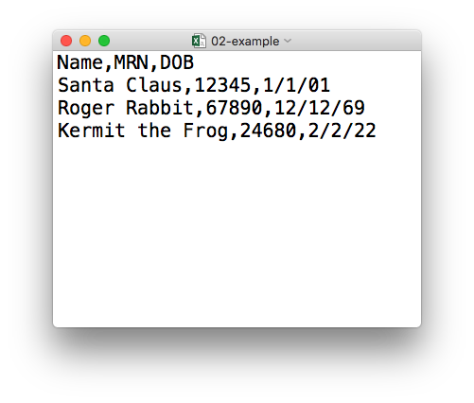
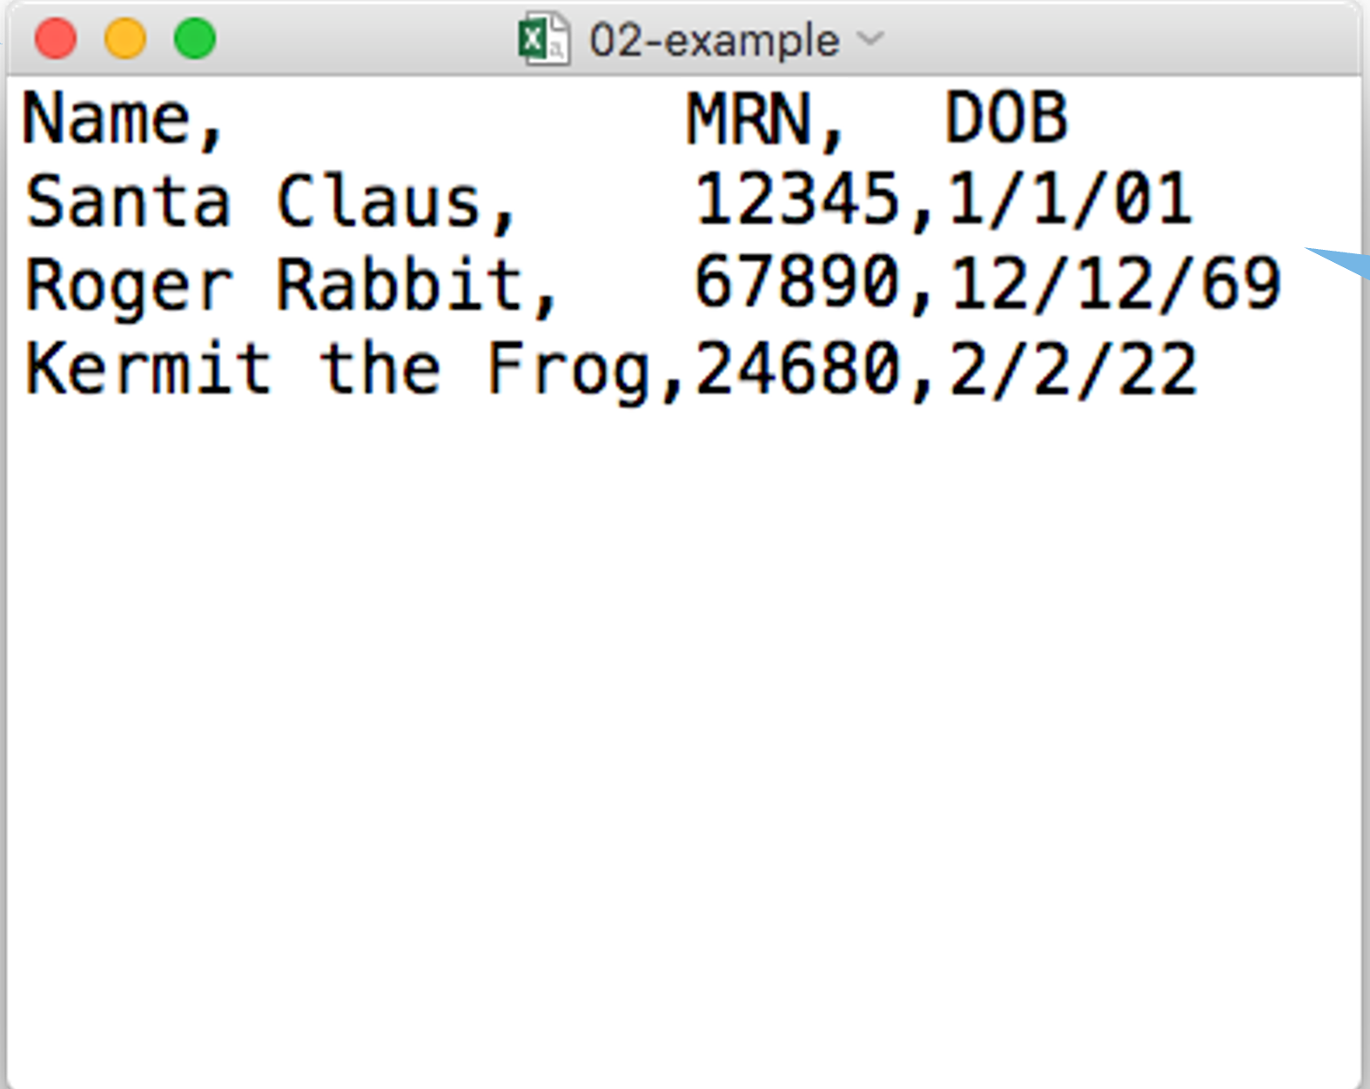
plain text (“flat”) file
csv
rectangular structure
Text
Notepad
CSV
Data
Notes:
For instance this is how we teach the concept of a a CSV file in the workshop.
There are many ways to approach teaching this piece of information, right?
A CSV is a medium for data storage or it’s a delimited file format.
When we review this concept we say A CSV file is a plain text file, which means you can open it in a text editor and look at it.
→
In this simple example we are using the concept of a text editor which is almost as old as the personal computer itself as a peg upon which we hook the new concept of the CSV file as a data storage format.

Slide 30
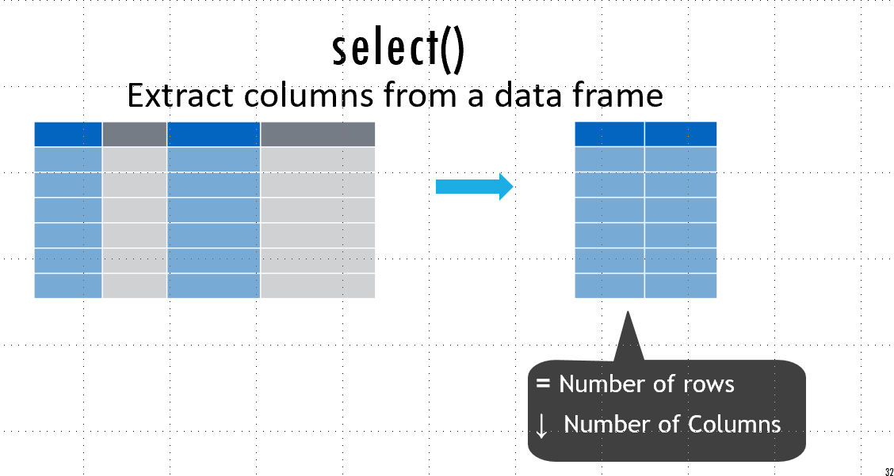
Dual Channels
Notes:
Another cognitive trick we use to help our learners register and recall data is teaching using dual channels.
Generally speaking Information gets into short-term memory primarily through your verbal channel (for speech) and visual channel (for images). people tend to rely primarily on one or the other, but when images and words complement each other, the brain is better at remembering them both: they are encoded together, so recall of one later on helps trigger recall of the other.

Slide 31
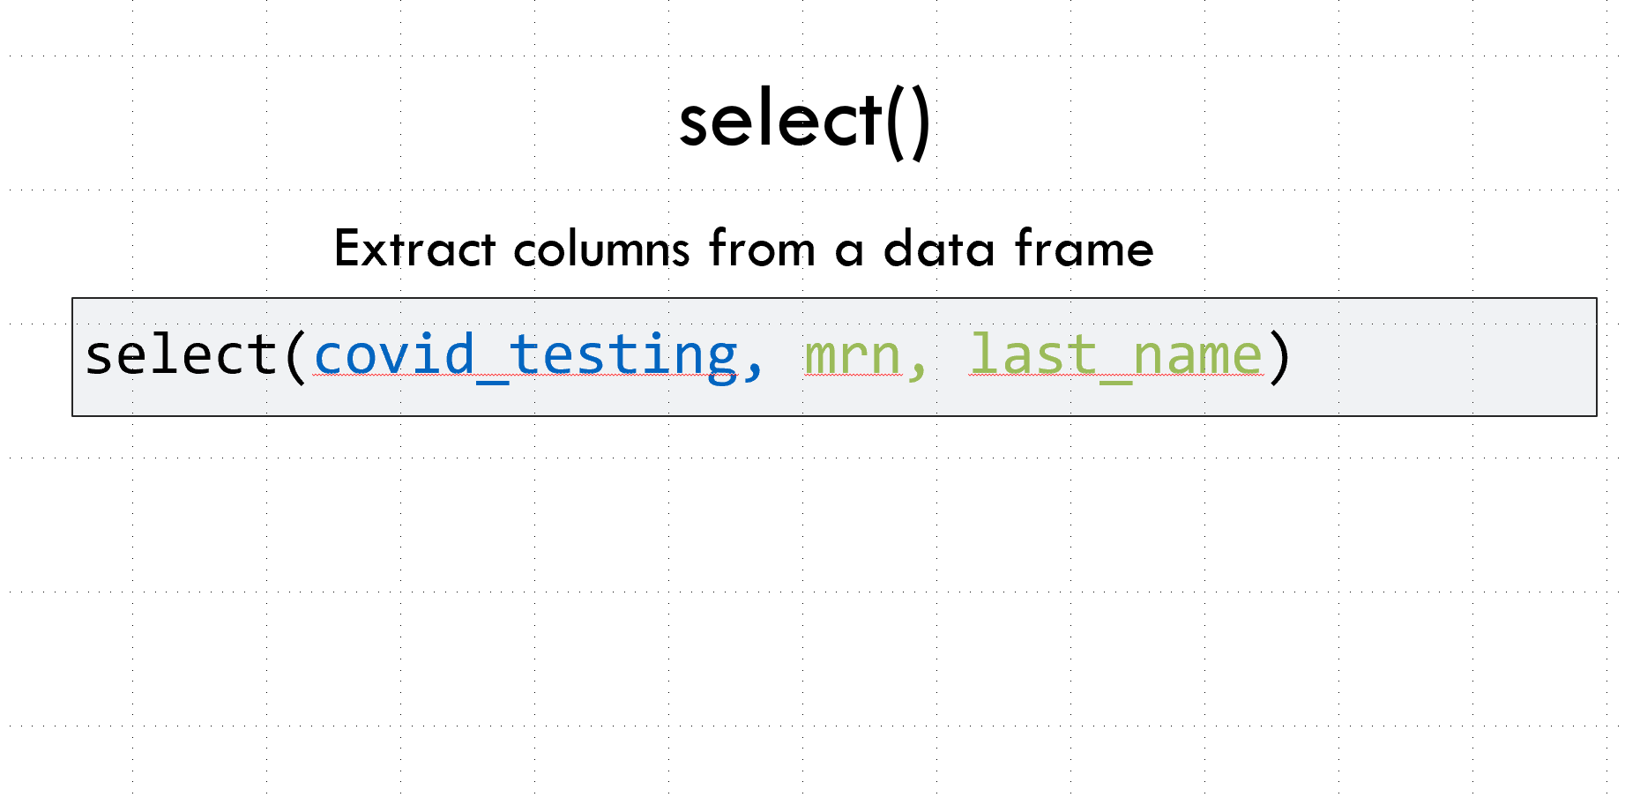
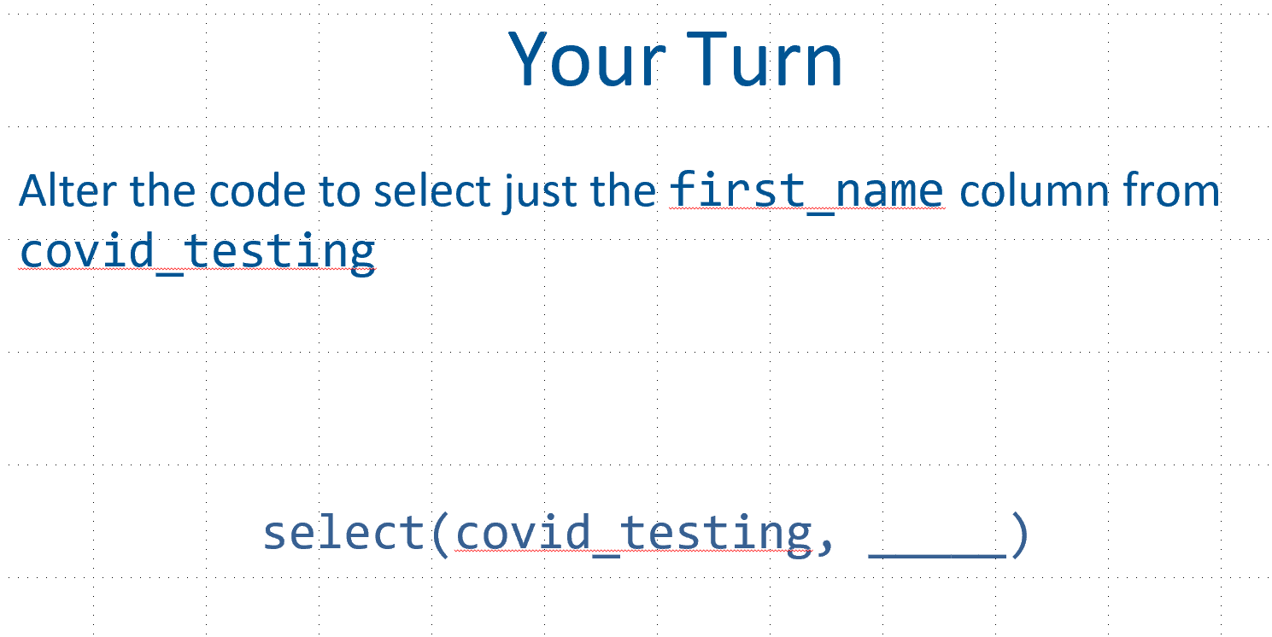
Faded Examples
Notes:
Another example of how we use the concept of cognitive load to focus learners on what we need them to understand is the use of faded examples. In faded examples the first example of a task is a complete use of a problem-solving strategy; each subsequent example gives the learner more blanks to fill in. The material that isn't blank is often referred to as scaffolding since it serves the same purpose as the scaffolding set up temporarily at a building site.
The reason is that this sequence of faded examples reduces load by focusing their attention on one aspect of the problem at a time. This is a generalizable finding: where there are patterns to solutions (and there almost always are), faded examples allow learners to pick up the solution strategy a step at a time
At each step, learners have a slightly larger problem to solve, which is less intimidating than a blank screen or a blank sheet of paper. Faded examples also encourage learners (and instructors) to think about the similarities and differences between various approaches.
A worked example is a step-by-step demonstration of how to solve a problem or do some task. By giving the steps in order, the instructor reduces the learner’s cognitive load, which accelerates learning. However, worked examples become less effective as learners acquire more expertise a phenomenon known as the “expertise reversal effect.” In brief, as learners build their
own mental models of what to do and how to do it, the detailed step-by-step breakdown of a worked example starts to get in the way. This is why tutorials and manual pages both need to exist: what’s appropriate for a newcomer is frustrating for an expert, while what jogs an expert’s memory may be incomprehensible to a novice

Slide 32
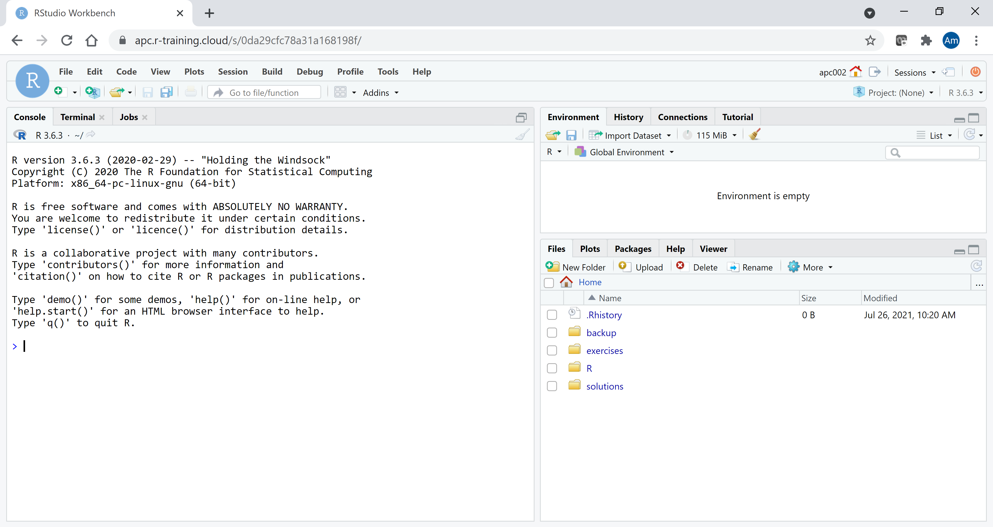
Teaching Online
Zoom
Break out rooms
Chat
Non-verbal feedback
Notes:
Finally I wanted to say a word about our pivot to teaching online. When we first developed this course it was in person and we couldn’t imagine doing it any other way.
To our great surprise we have had tremendous success migrating our material to an online virtual meeting format. We make heavy use of some of the typical features like breakout rooms, chat and non-verbal feedback.
An absolute requirement was using a cloud based version of the Rstudio software, which is freely available and if you have some additional technical know how like my colleague Stephan you can set up a lot of features to customize the experience even more.

Slide 33

Course Projects
Machine Learning Models Improve Diagnostic Yield of Peripheral Blood Flow Cytometry (Lisa Zhang)
Modeling Alzheimer’s Disease-Copathology in a Cohort of Patients with Primary Lewy Body Neuropathology (David Dai)
A Shiny App for Exploring RNA-Seq Data (Jess Li)
Notes:
When we teach the course at our home institution Penn we're able to add on to the workshop experience the concept of a course project. In the course project we invite students to complete an optional project in the form of a R Markdown document that addresses some clinical or research question, and we have had great success not only in reinforcing our teaching but also actually producing a deliverable and occasionally a publication.

Slide 34







Notes:
So we have taught this workshop in several venues, at our home instutions as well as conferences so we're now in a position where we can actually reflect on some of the challenges and skepticisms that were addressed to us when we first began teaching the workshop.

Slide 35
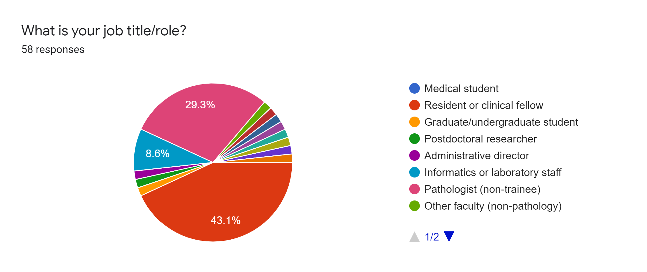
Who are we teaching?
Notes:
This data derives from our workshops at the association for pathology informatics, API, but they are reflective of what we see generally.
Our students in these data are predominantly Pathologists or pathology trainees.

Slide 36
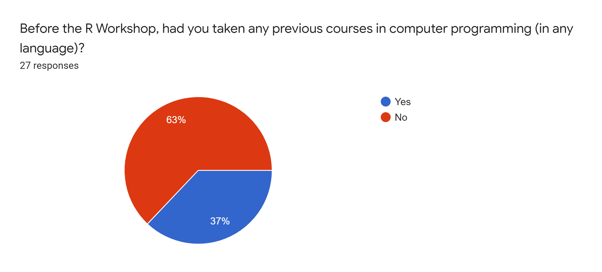
Who are we teaching?
Notes:
And 2/3 had not taken any previous courses in computer programming but 1/3 had. That’s unusually high but probably relates to the fact that we were teaching at an informatics conference.

Slide 37
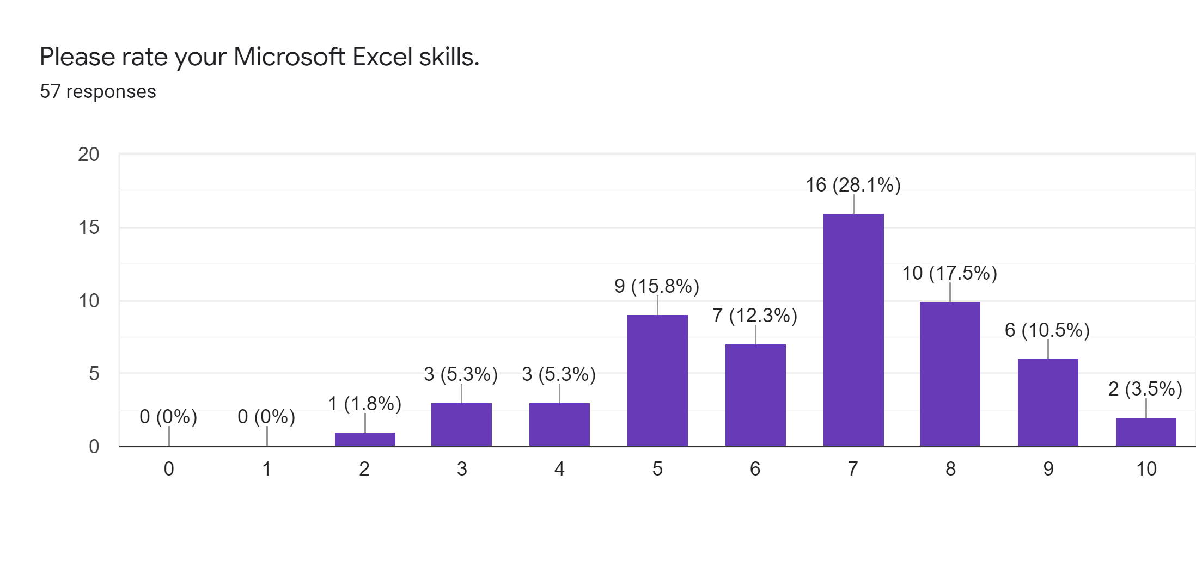
Notes:
Self reported excel skills on a scale of 1-10 were relatively high

Slide 38
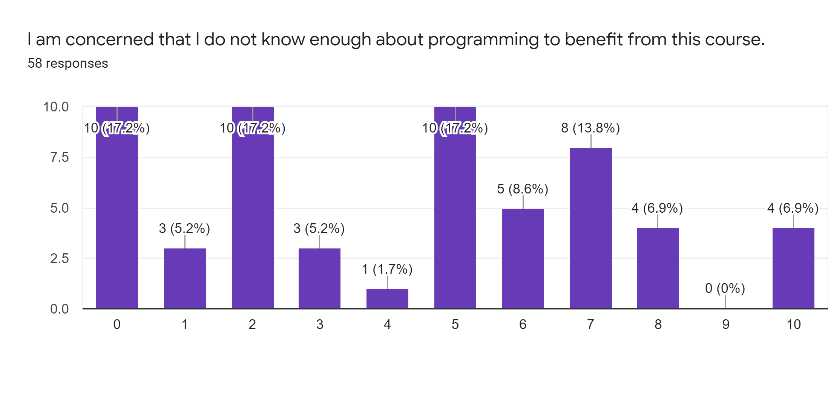
Notes:
we asked participants about their confidence in their programming skills. The prompt was “I’m afraid that I don’t know enough programming to benefit from the course” and there was sort of a broad range of responses, with some people who were very afraid that they didn’t know enough programming to benefit from the course.

Slide 39
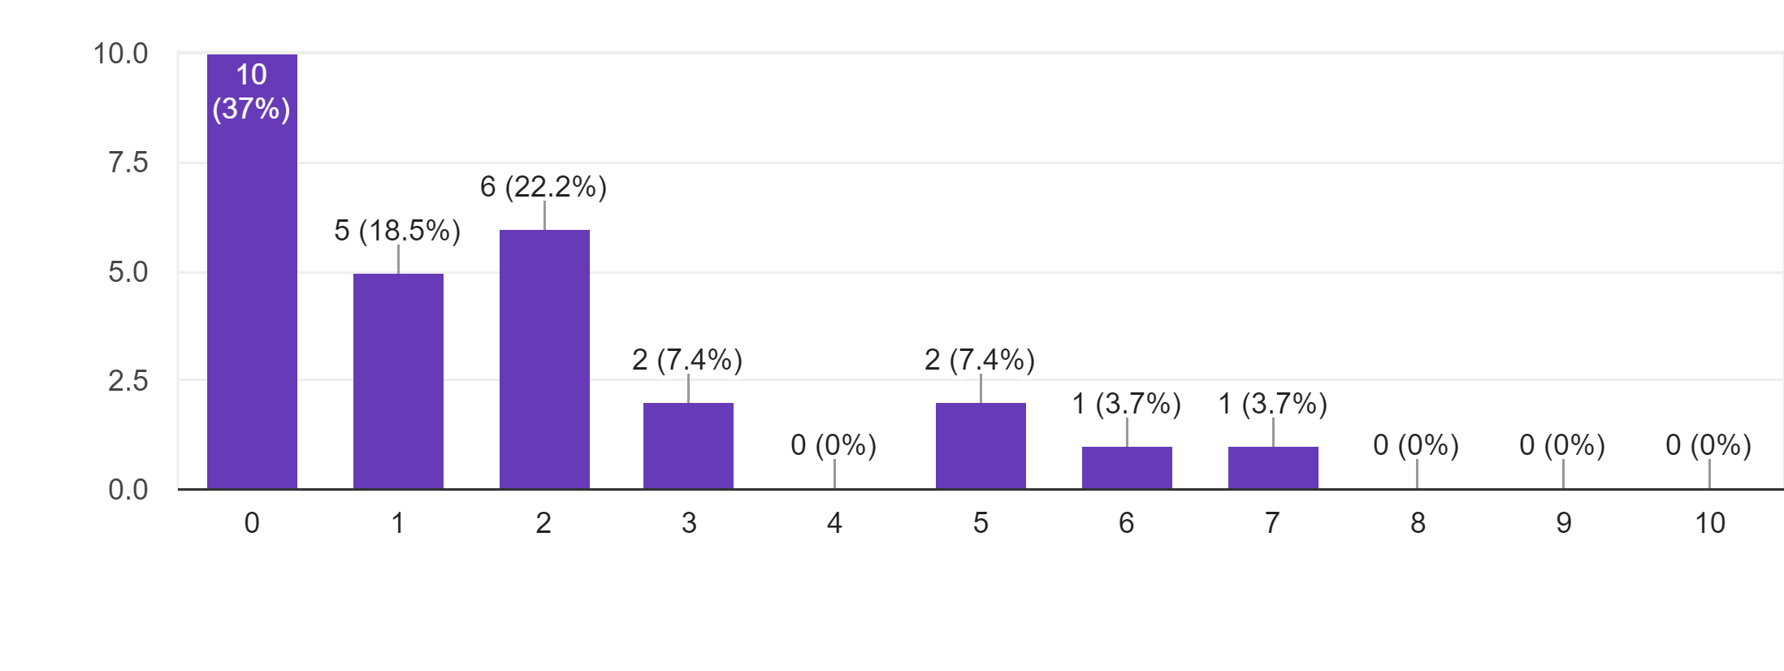
“The required level of knowledge about programming was too high.”
Notes:
In the post-course survey, the same students asked if the felt that the required level of knowledge about programming was too high. Pretty much everyone answered that it wasn’t too difficult
We firmly believe that the biggest barrier to adoption of R and similar tools isn't that its too difficult but rather that there is a perception that it is difficult.

Slide 40
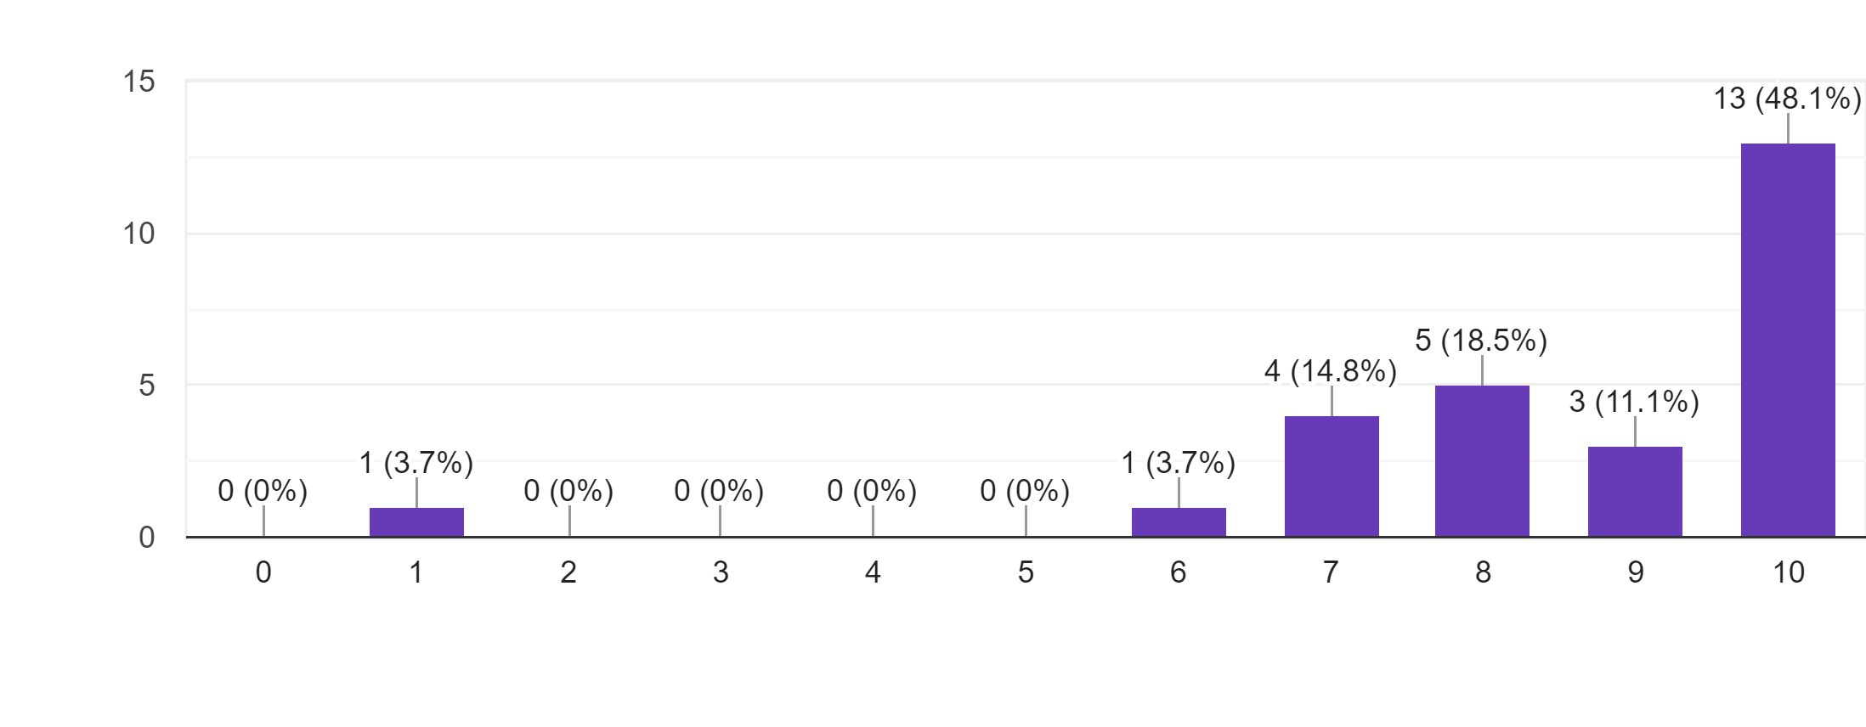
“The Introduction to R workshop stimulated my interest in the subject of reproducibility”

Slide 41
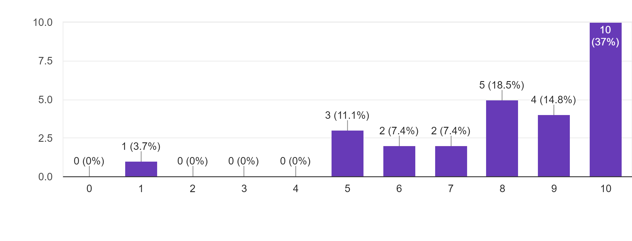
“The Introduction to R workshop increased my confidence in my ability to define reproducibility”

Slide 42
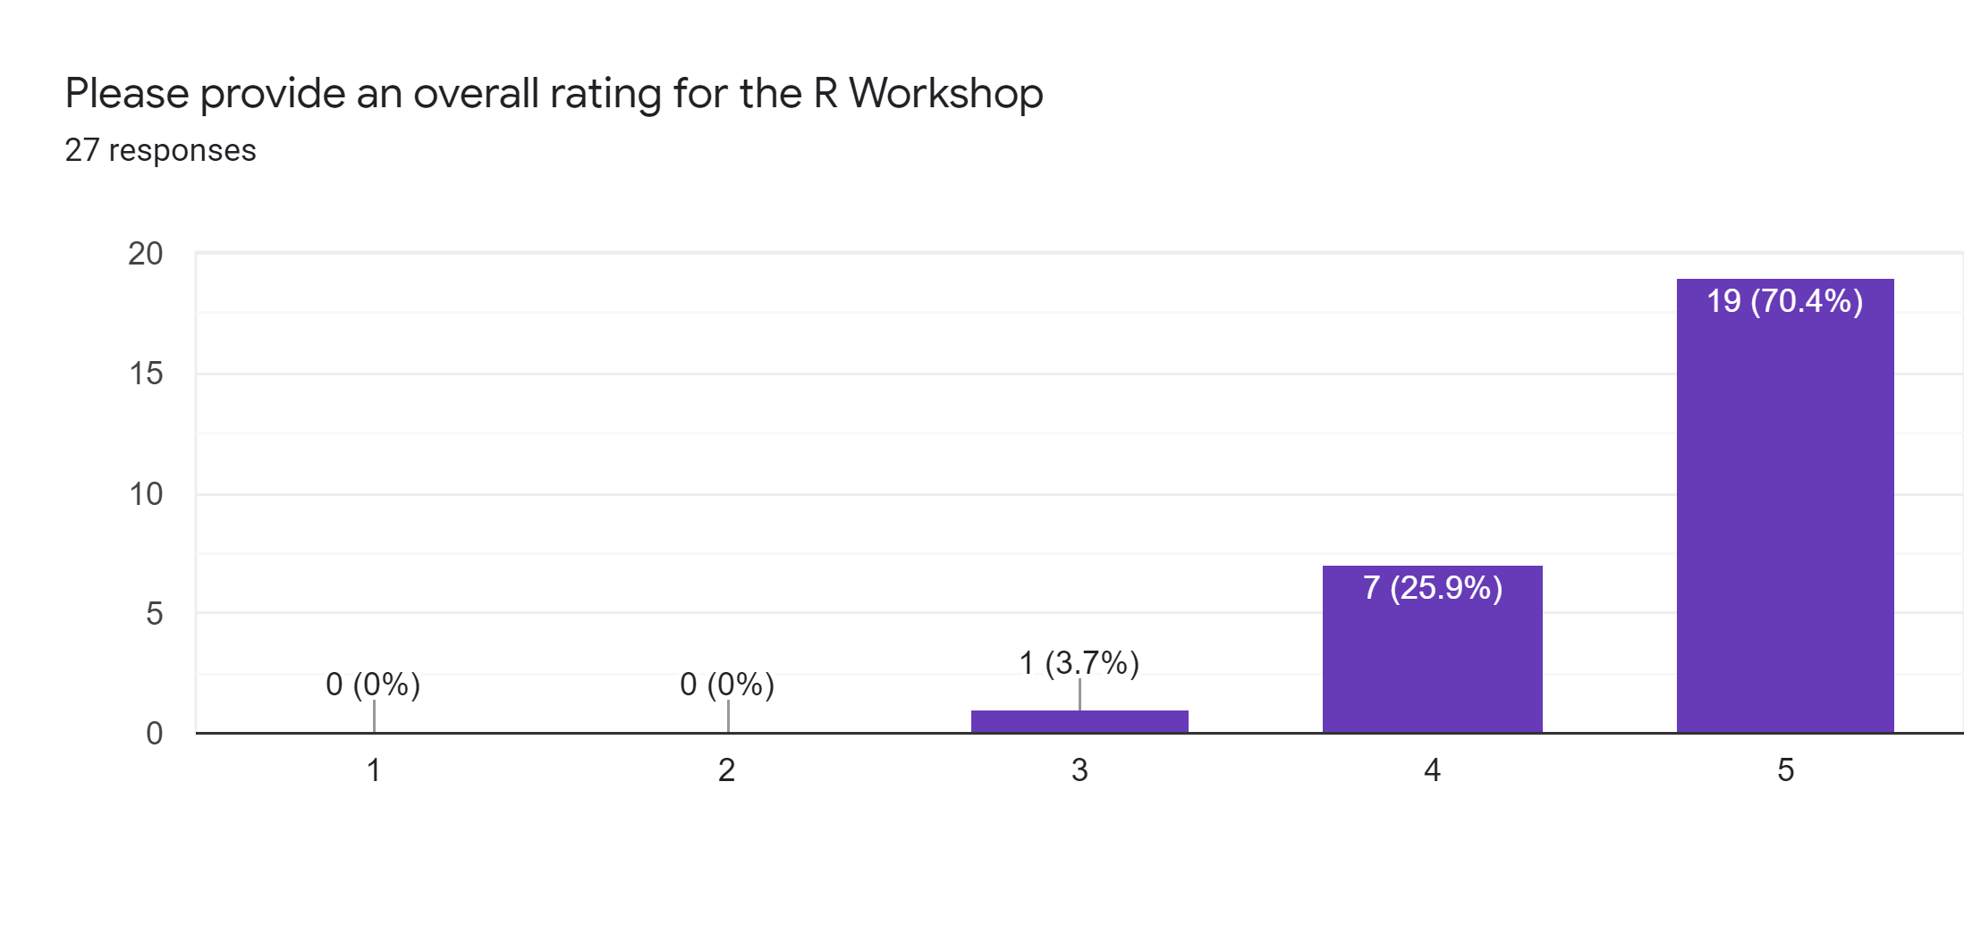

Slide 43
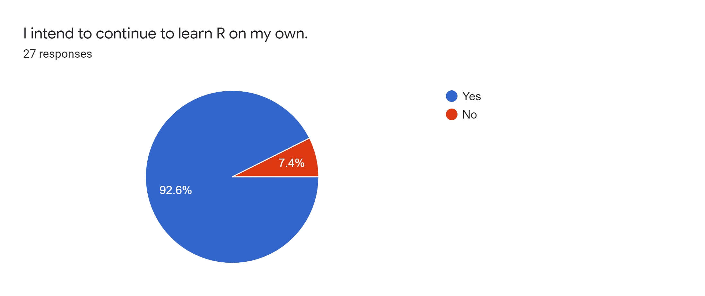

Slide 44


Slide 45
https://github.com/skadauke/intro-to-r-for-clinicians-chop
Notes:
I also taught an adaptation of this curriculum, together with colleagues from a number of institutions, at the 2019 and 2020 Pathology Informatics Summits and at the 2020 R/Medicine conference. And we plan to teach it again this year and both venues, virtually, so if you're interested please consider joining.
(**) The current version of the materials for the course are available at this URL. I encourage you to download and use them and adapt them for your own teaching.
Also, I have video recordings of the entire R/Medicine workshop that uses these materials – if you’re interested, email me!

Slide 46




Teaching
Community of Practice
Notes:
In addition to teaching trainees, allowing for (**) lateral knowledge transfer by building and supporting communities of practice is a powerful way to disseminate knowledge

Slide 47

250+ users from all departments
User Group Meetings
Monthly talks, given by volunteers throughout CHOP
Slack Chat
Get help, network, share ideas
R Workshops
From basic data wrangling to machine learning
Notes:
When I came to CHOP, I co-founded the CHOP R User Group to create a local community of practice, and now we have more than 250 users from all departments.
We organize monthly talks, given by volunteers throughout CHOP.
We maintain a Slack chat room where anyone can post to get help, network, or share ideas.
And we teach R workshops, from basic data wrangling to machine learning.

Slide 48

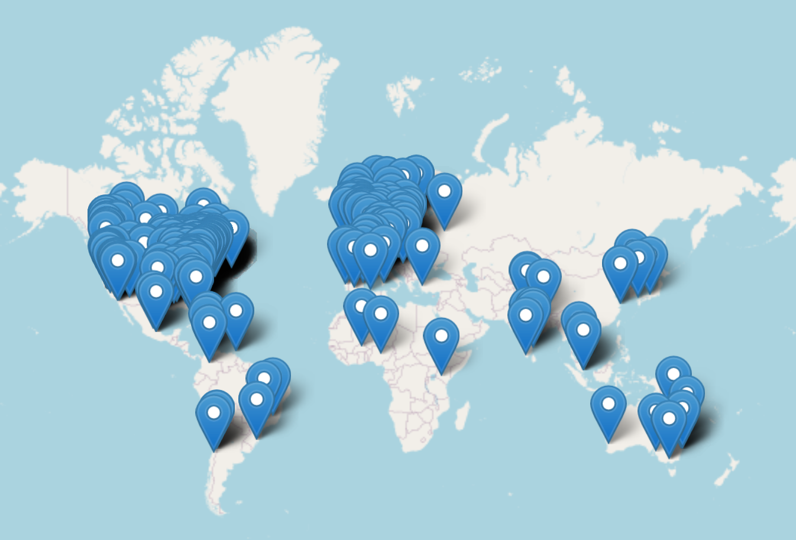
550+ Registrants
32% non-US (43 countries)
16% physicians
5X growth from previous year
R Workshops
101: Intro to R for Clinicians
201: Intro the Machine Learning with Tidymodels
Notes:
Last year I had the honor to chair the 2020 R/Medicine conference, and I wanted to briefly highlight it here as a more global opportunity to engage with a community of practice.
R/Medicine is a community that aims to encourage adoption of reproducible data processing in clinical practice using R. R/Medicine hosts an annual conference, which was virtual last year because of COVID-19.
A major focus of R/Medicine is clinical laboratory medicine. We had presentations from Steve Master on behalf of AACC, and Daniel Holmes on behalf of MSACL, about each society’s vision for using R in clinical laboratory medicine, and there was a fairly large contingent of clinical lab medicine folks there.
And this was a truly global event, with participation from 43 countries; no doubt because the virtual format removed barriers.

Slide 49
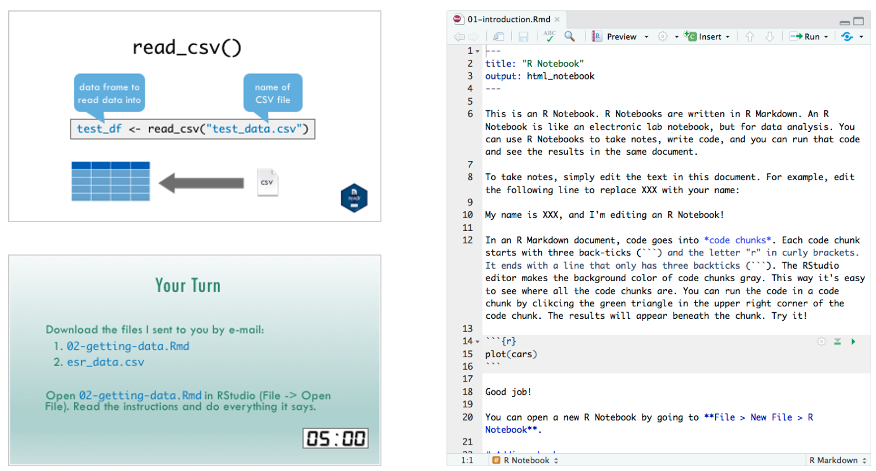

Recap
A streamlined day curriculum can teach Pathology trainees sufficient R Markdown to perform a research or quality improvement project.
Communities of practice such as a local R User Group and engaging with the R community in Pathology and Lab Medicine can support R learning.
Notes:
To recap,
(**)

Slide 50

Educational Research
Resources from R community
Concision
Iteration

Slide 51
Cognitive Load Theory
Learner Personas
Mental Models
Dual Coding

Slide 52
Questions
Can you convince students to consider replacing excel?
Can you convince students of the importance of reproducibility?
Can you do it efficiently in a workshop?
Notes:
Ruthless efficiency

Slide 53
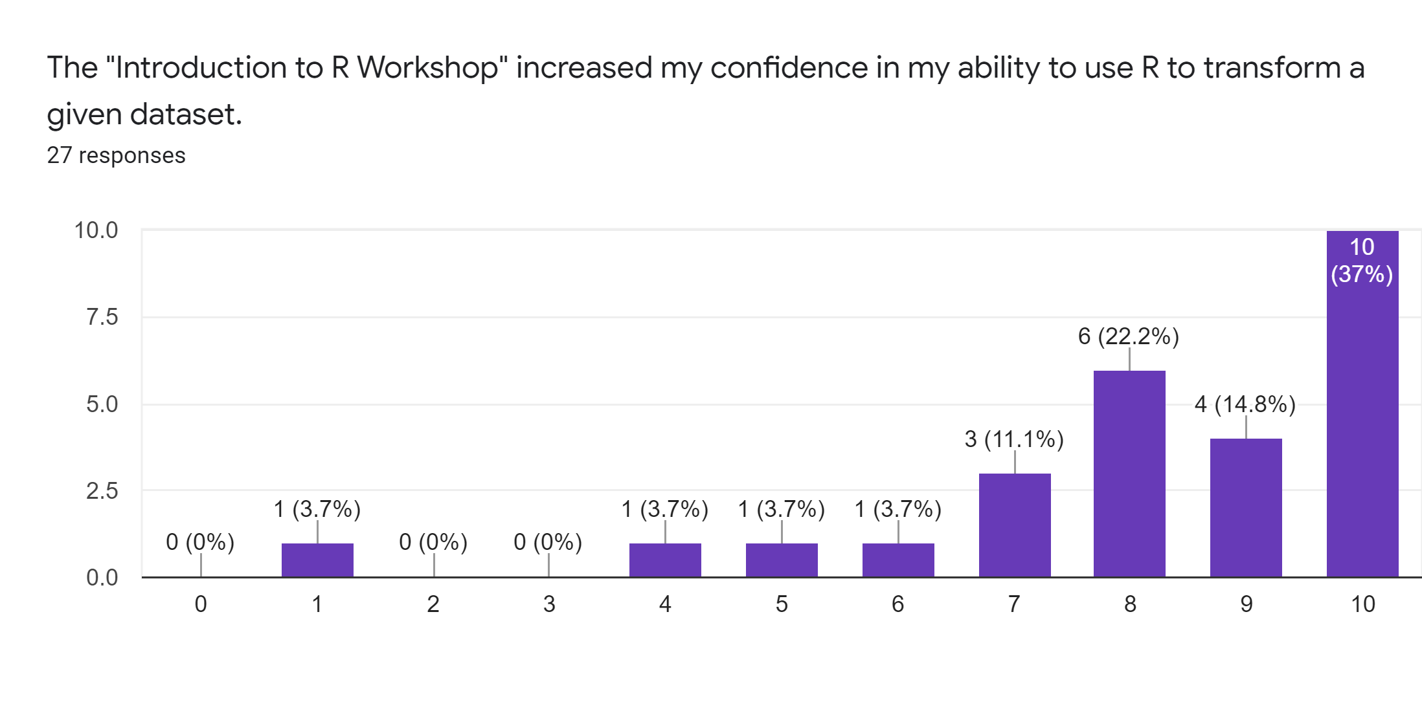

Slide 54
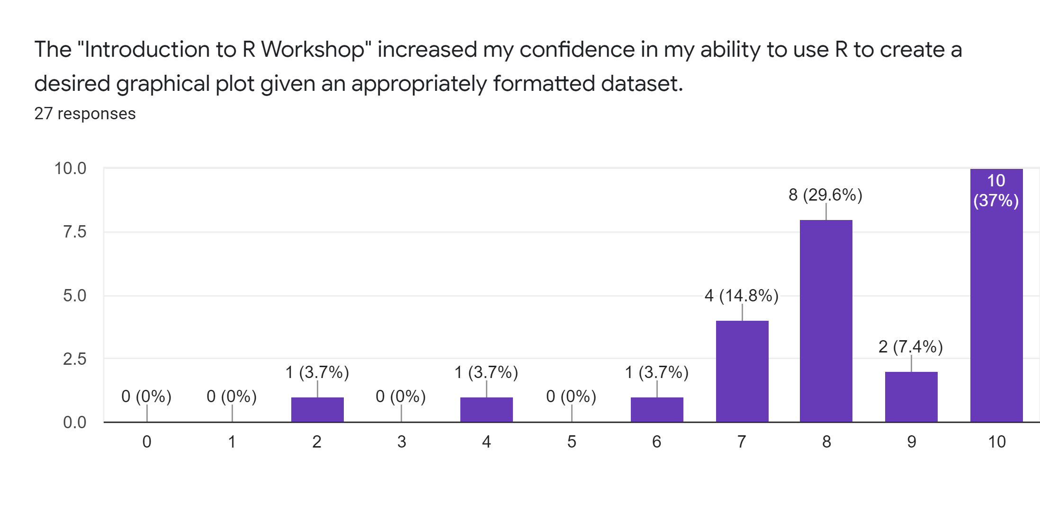

Slide 55


Slide 56
Learner Personas
1. General background
2. What they already know
3. What is motivating them
4. How the lesson will help them
5. Special needs
Notes:
Learner personas are profiles that represent the target audience for whom you are designing a learning program
Personas help you remember one of the most important tips of teaching: you are not your learners. The people you teach will almost always have different backgrounds, different capabilities, and different ambitions than you; personas help you keep your lessons focused on what they need rather than on what your younger self might have wanted

Slide 57
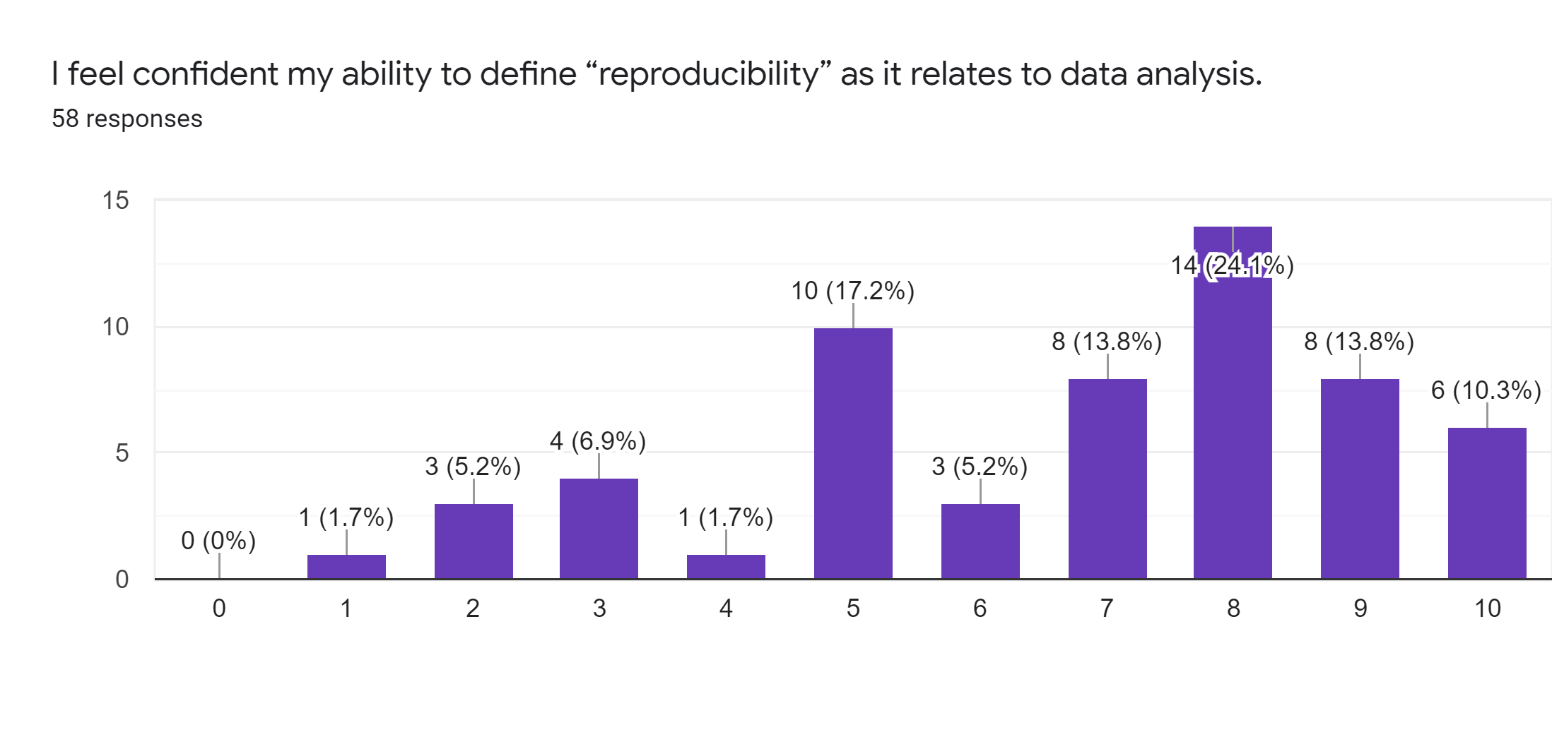

Slide 58
Learner Personas
Resident who has heard of R and wants to know what all the fuss is about
MD PhD excel wizard feels limited – wants to know what else is out there
Junior faculty who previously took an R workshop without success

Slide 59
Build Mental Models
R
Rstudio
Environment
Console
Editor
Function
Argument
Output
Object
Assignment
Tidyverse
Tidy Data
Dataframe
Pipe
Dplyr
Ggplot2
Vector
List
NA
Working Directory
Project
CSV
Package
Error
Warning
Rmarkdown
Markdown
Reproducibility
Dashboard
Data Types
HTML

Slide 60
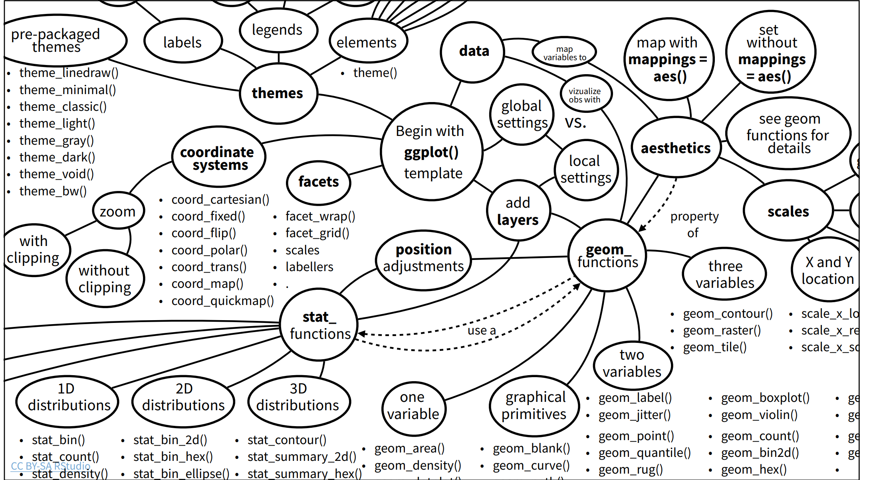

Slide 61
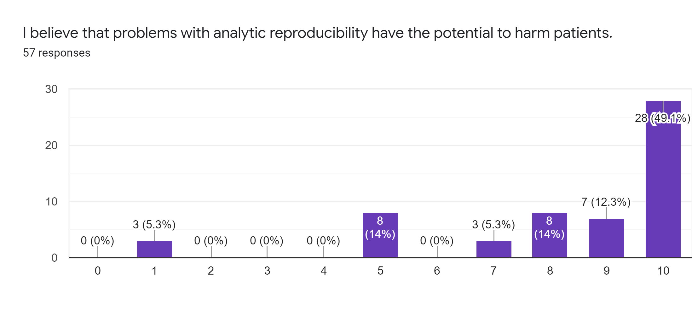
Notes:
We were able to convince students that

